Slide 1

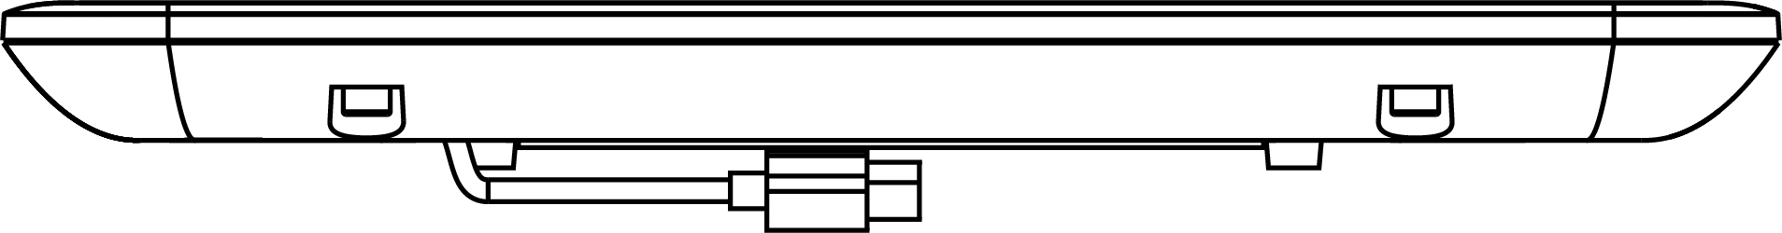
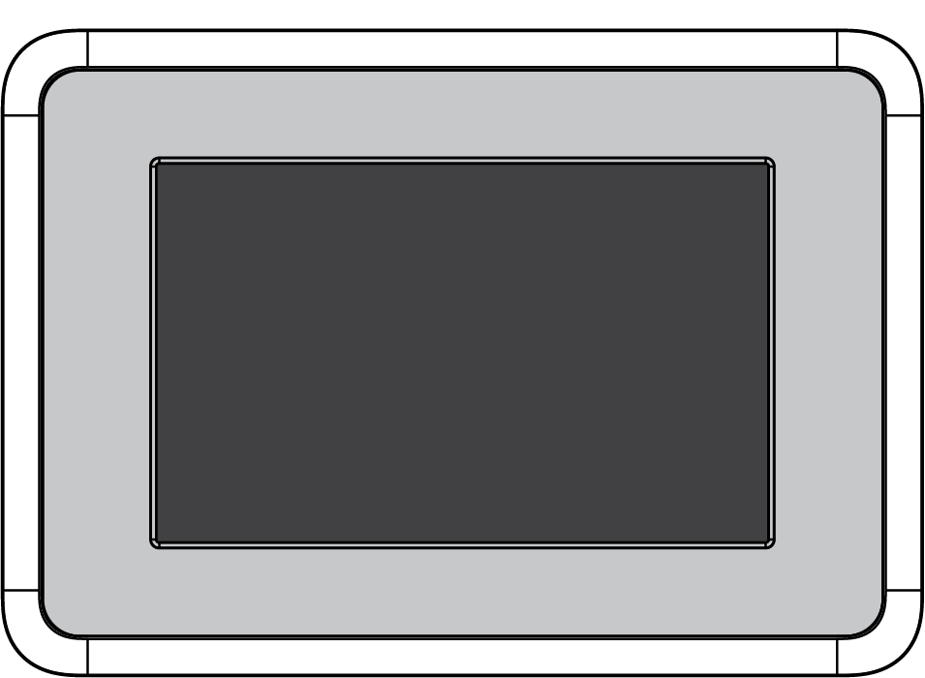
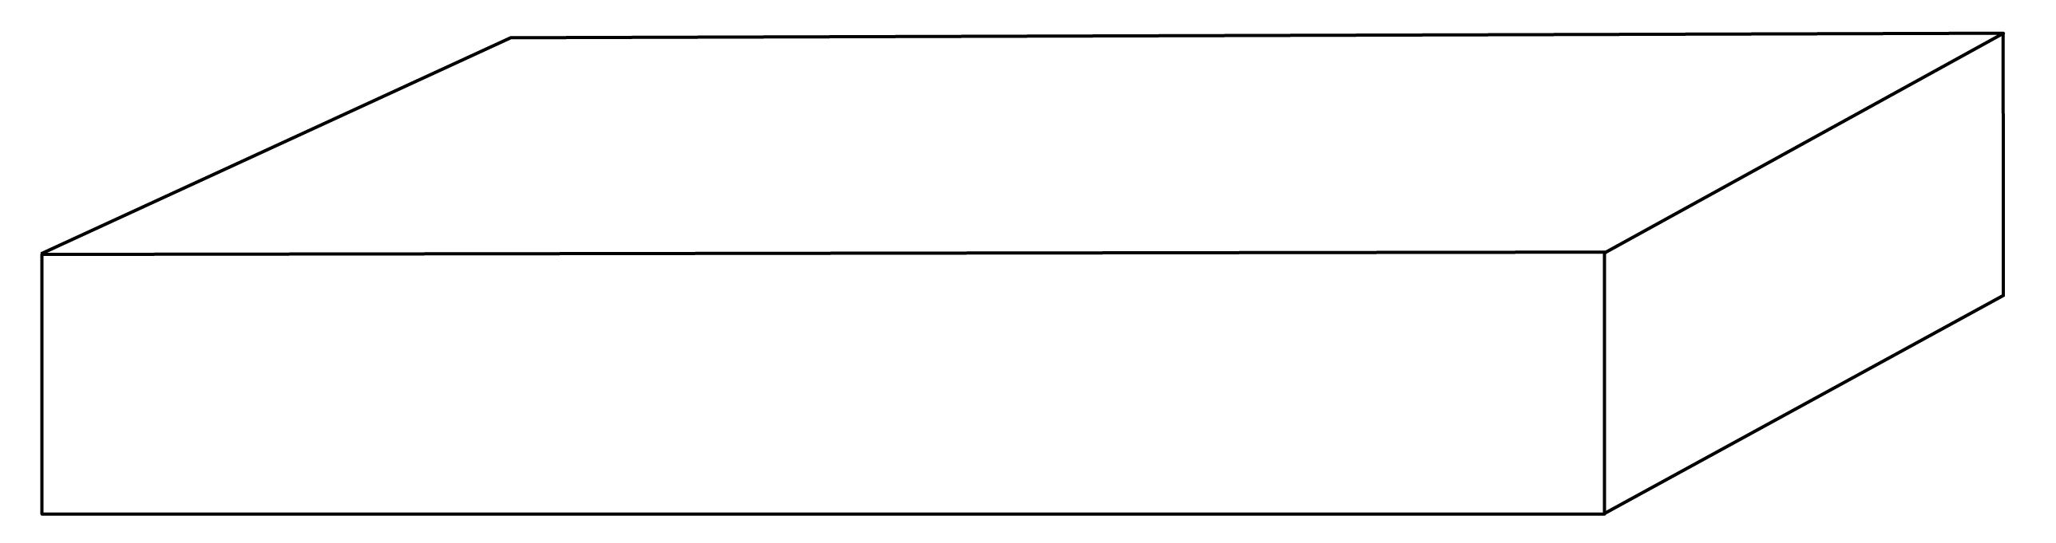
Technical Data Sheet
Smiley Touch™ T5100
V1.0
User interface
Weight without battery: 1.3 kg / 2.9 lbs Battery type: li-ion Battery weight: 120 g / 0.26 lbs
2.5 cm / 1.0”
HONT5100: 24.9 cm / 9.8"
22.6 cm / 8.9”
32.2 cm / 12.7”
Smiley Touch package includes:
Smiley Touch user interface Attention sign holder V sign arm Thumb nut Hex screws | Smiley Touch frame Leg plate Hex key Square baseplate | Power supply Power cable Assembly Guide Cardboard box
SERIAL NUMBER
18.0 cm / 7.1”
Weight max. 11.4 kg / 25.1 lbs
37.0 cm / 14.6”
107.0 cm / 42.1”

Slide 2
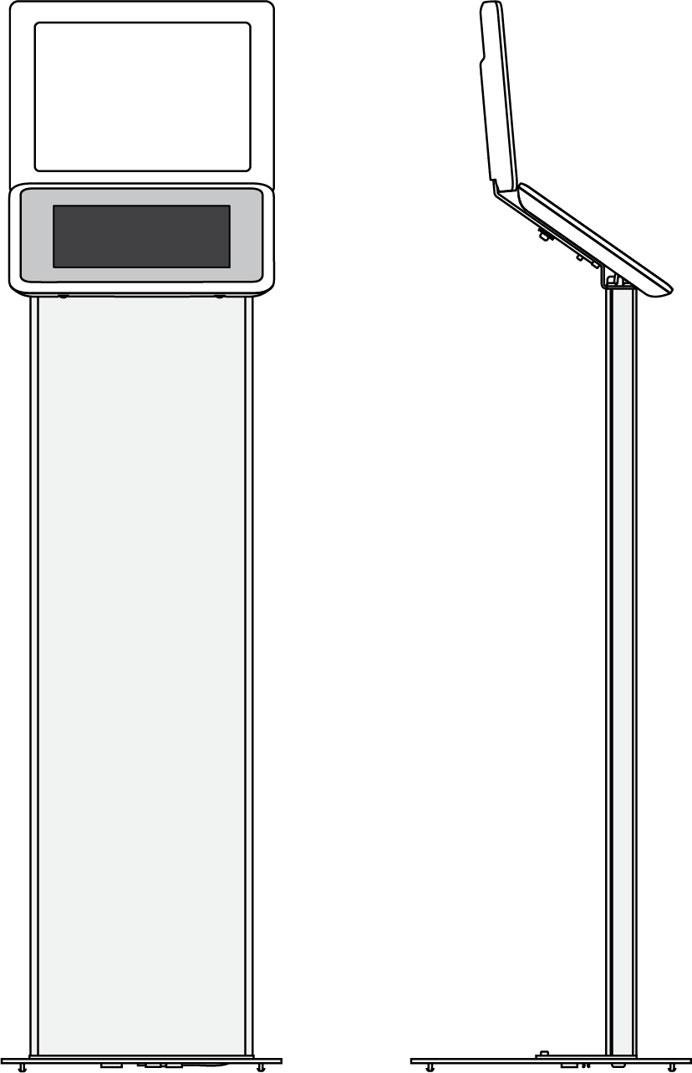
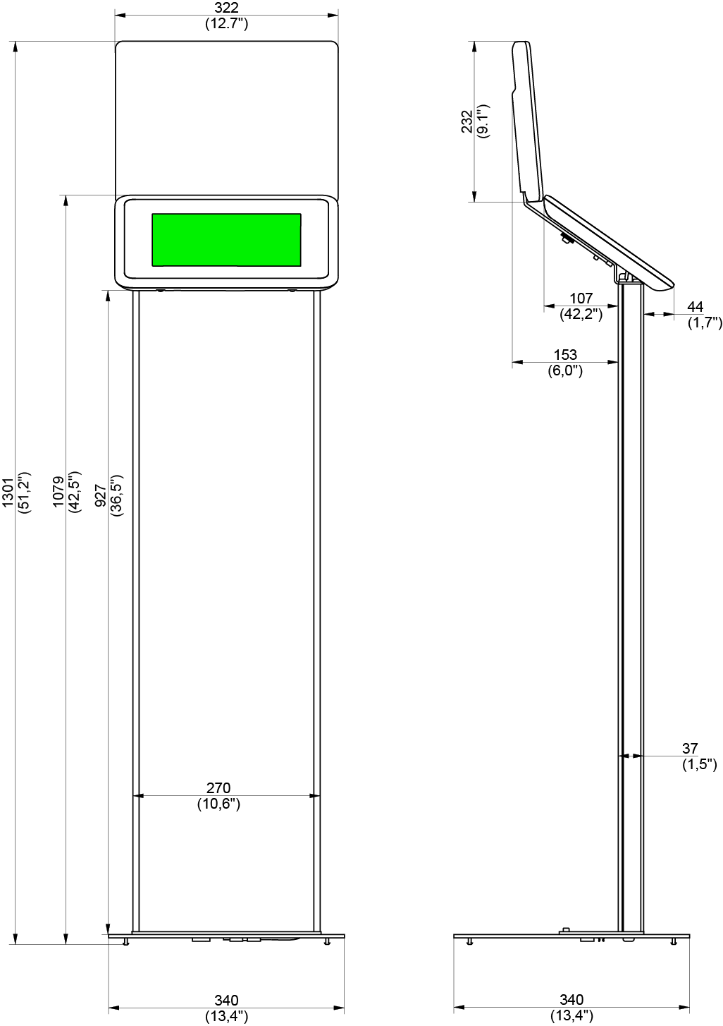
Technical Data Sheet
Smiley Touch™ T5100
Smiley Touch with branding leg plate
Weight: 8.7 kg / 19.2 lbs Total height: 130.1 cm / 51.2" Attention sign size: A4 / Letter
32.2 cm / 12.7”
23.2 cm / 9.1”
10.7 cm / 4.2”
4.4 cm / 1.7”
15.3 cm / 6.0”
107.9 cm / 42.5”
92.7 cm / 36.5”
130.1 cm / 51.2”
27.0 cm / 10.6”
3.7 cm / 1.5”
34.0 cm / 13.4”
34.0 cm / 13.4”

Slide 3

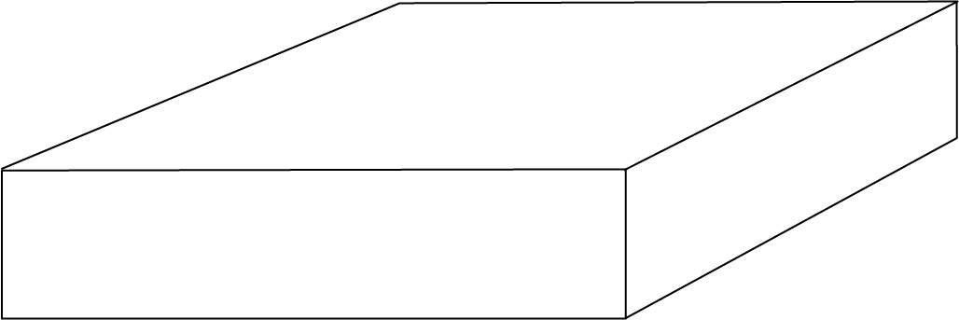
V1.0
Technical Data Sheet
Smiley Touch™ T5100
User interface
Weight without battery: 1.3 kg / 2.9 lbs Battery type: li-ion Battery weight: 120 g / 0.26 lbs
3. SMILEY TOUCH WALL
4.0 cm / 1.6”
HONT5100: 24.9 cm / 9.8"
22.6 cm / 8.9”
32.2 cm / 12.7”
Smiley Touch Wall package includes:
Smiley Touch user interface Wall mount Power supply | Power cable Assembly Guide Cardboard box
SERIAL NUMBER
10.0 cm / 3.9”
Weight max. 2.0 kg / 4.4 lbs
30.0 cm / 11.8”
42.5 cm / 16.5”

Slide 4
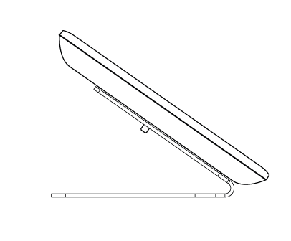

Technical Data Sheet
Smiley Touch™ T5100
V1.0
User interface
Weight without battery: 1.3 kg / 2.9 lbs Battery type: li-ion Battery weight: 120 g / 0.26 lbs
13.7 cm / 5.3”
32.2 cm / 12.7”
19.6 cm / 7.7”
Smiley Touch Wall package includes:
Smiley Touch user interface Wall mount Power supply | Power cable Assembly Guide Cardboard box
SERIAL NUMBER
19.1 cm / 7.5”
Weight: 2,27 kg / 5 lbs
31.1 cm / 12.2”
35.6 cm / 14”

Slide 5
Technical Data Sheet
Smiley Touch™ T5100
V1.0
MODEL | HONT5100
Approvals | RoHS, CE, FCC
Power charger input | 100-240V~0.30A 50-60Hz
Device power input | 5.0Vdc 1.55A
Max. power consumption | 7.75W
Battery | 7040mAh Li-Po
Operating temperature | Ambient +5 to +35 C / +41 to +95 F
IP class | IP30
Flammability | UL94 V0
Frequency Bands | HONT5100
2G GSM | GSM 850, GSM 900, DCS1800, PCS 1900
3G UMTS | B1 (2100), B2 (1900), B4 (AWS), B5 (850), B8 (900)
4G FDD LTE | B1 (2100), B2 (1900), B3 (1800), B4 (AWS), B5 (850), B7 (2600), B8 (900), B12 (700), B17 (700), B20 (800), B28 (700), B66 (AWS-3)
4G TDD LTE | B38 (2600), B40 (2300)
Dimensions (HxWxD): | HONT5100
With Branding leg plate | 130.1 x 34.0 x 34.0 cm / 51.2 x 13.4 x 13.4”
Wall | 22.6 x 32.2 x 4.0 cm / 8.9 x 12.7 x 1.6”
Table | 13,1x32,2x20,2cm/5.2x12.7x8”
Weight: | HONT5100
With Branding leg plate | 8.7 kg / 19.2 lbs
Wall | 1.3 kg / 2.9 lbs
Table | 2,27 kg / 5 lbs
Package dimensions (HxWxD): | HONT5100
With Branding leg plate | 18.0 x 107 x 37 cm / 7.1 x 42.1 x 14.6”
Wall | 10.0 x 42.5 x 30.0 cm / 3.9 x 16.5 x 11.8”
Table | 19.1 x 35.6 x 31.1 cm / 7.5 x 14 x 12.2”
Package weight: | HONT5100
With Branding leg plate | 11.4 kg / 25.1 lbs
Wall | 2.0 kg / 4.4 lbs
Table | 2.7 kg / 5.9 lbs

